Slide 1
Applied Geographic Information Systems and GIS Programming Day 2: Spatial Analysis using Vector Data
Yi Qiang
Department of Geography
University of Hawaii - Manoa

Slide 2
Course evaluation
4 lab exercise (15% * 4)
Finish the exercises in the computer lab
Finish by yourselves and don’t copy others
Submit answers no later than 11:59pm the next day
Submit in Microsoft Word file format
1 project (30%)
Attendance (10%)

Slide 3
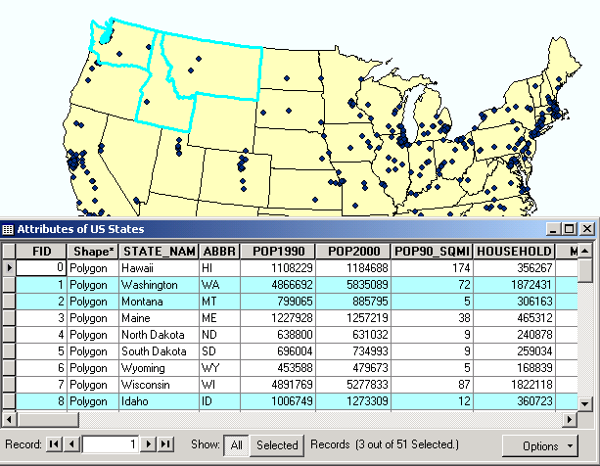
Recall of the previous class
Three components of GIS data: space (where), time (when), and attributes (what)
Where
When
What
Three Ws in GIS data
Vector data and attribute table

Slide 4
Recall of the previous class
Two representation of the world
The discrete world: discrete objects with clear boundary in an empty space
Continuous world: a continuous field where every location has a value
Two GIS data types
Vector: point, lines, and polygons, mostly used to model discrete objects
Raster: grid of cells (pixels) with equal size and shape, mostly used to model continuous field

Slide 5
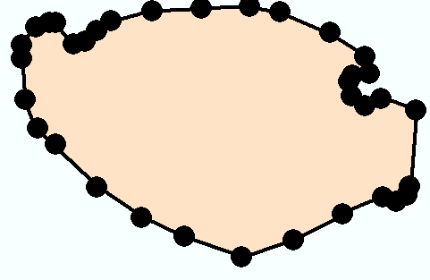
Discrete objects in vector data
Vector object is formed by points or series of points
Polygon
Vertices
Line
Points
Nodes
Y
X

Slide 6
Only keeping the location of nodes is not enough
1 polygon or 2 polygons?

Slide 7
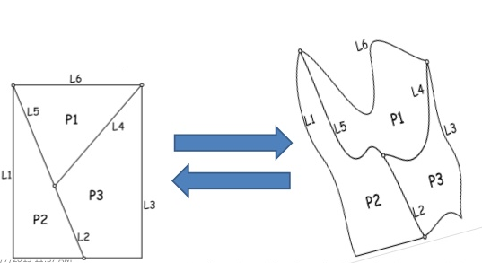
Spatial topology
Topology is concerned with the properties of space that are preserved under continuous deformations, such as stretching, crumpling and bending.

Slide 8

Königsberg’s Seven Bridge Problem
Find a walk through the city that would cross each of those bridges once and only once.

Slide 9
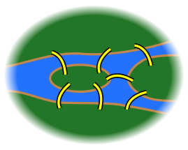
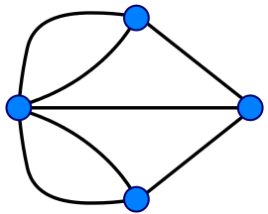
Simplify the problem
Solved by Leonhard Euler

Slide 10
Topology
In GIS, topology refers to the relative spatial relations between features.
Topology is about how features are connected and which features are adjacent to each other.
Topology distinguishes GIS data models from non-topological data models supported by many CAD, Photoshop and other graphics systems

Slide 11
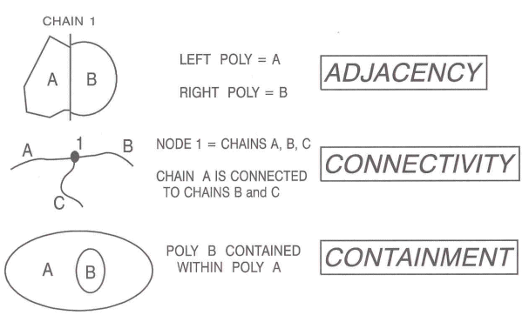
Topology
Can be viewed as a mathematical procedure that determines spatial relationships and properties, including:
The three Cs
Connectivity (Highway US 75 connects to IH 45)
Coincidence--same location (Red River & TX/OK border)
Contiguity--adjacency or “next door” (TX & OK)

Slide 12
Topology Type I: Arc-node topology
Nodes are the end-points of arcs. Arc-node topology keeps track of which arcs are connected to other arcs through shared nodes X It defines length, direction, and connectivity for arcs.
The from-node is an arc’s starting point; the to-node is its ending point.
They are determined as you digitize your data.
You can tell the from-node and to-node by its order.
Arcs connect if they share a node.

Slide 13
Topology Type II: Polygon-arc topology
Polygon-arc topology expresses the relationship between the arc features and the polygon features for which the arcs create boundaries. It defines area and adjacency. A set of arcs that form a closed figure define the area of a polygon. Polygons are stored as a list of arcs to avoid redundancy. Two polygons are adjacent if they share an arc.

Slide 14
Topology Concept III Left-right topology
Left-right topology refers to contiguity -- how polygons are associated with their neighboring polygons. Each arc has a list of which polygons are on the right side and which are on the left side. GIS uses this information to determine from one polygon what the adjacent polygons are:
1
5
2
4
6
3
7

Slide 15
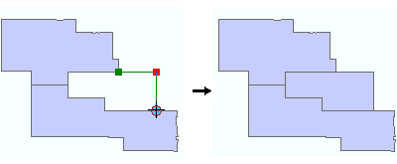
Auto-complete Polygons
Why we need topology in GIS

Slide 16
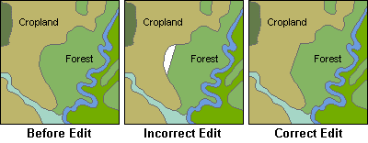
Why we need topology in GIS
Using topology to prevent editing errors

Slide 17
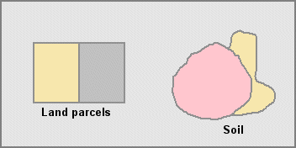
Represent adjacency (Common Border)
Why we need topology in GIS
The primary purpose of a topology is to define spatial relationships between features

Slide 18
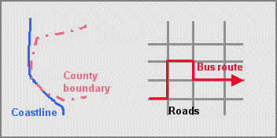
Preserving Coincidence
Why we need topology in GIS

Slide 19
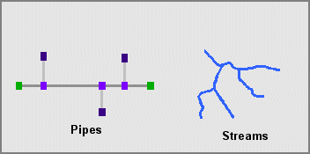
Preserving Connectivity
Why we need topology in GIS

Slide 20
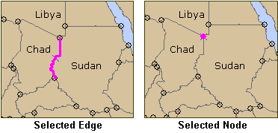
Common Topology Elements
Both edge and node are treated as single elements
Multiple copies of them stored in the GIS data are deleted as if they were one

Slide 21
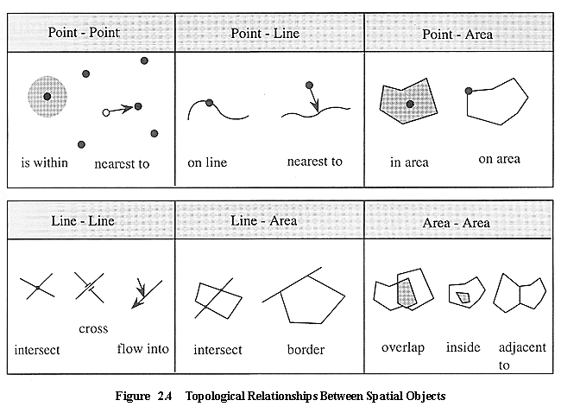
Topological relations

Slide 22
Query in GIS
The process of selecting information from a GIS by asking spatial or logical questions of the geographic locations OR attributes.
Basic query operations may be combined to select complex sets of information - similar syntax as SQL language
Query by attributes (attribute query)
What is found at a location (what is where)
Query by location (spatial query)
Where can you find a feature (Where is what)

Slide 23
Examples of Queries
Find me all the land parcels that
Are in Syracuse, NY
That are at least 2 Acres in size
That changed hands in the last 2 years
That have a assessed value of at least 1 million
That are classed residential

Slide 24
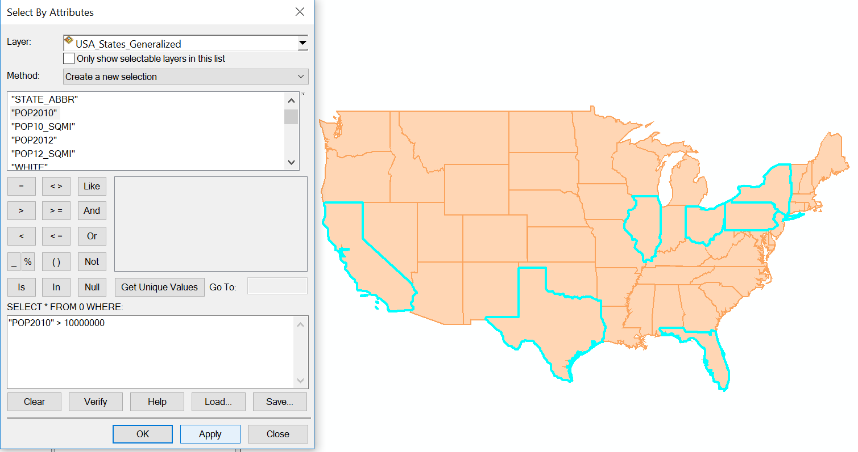
Query by attribute
Make selections according to the values in attributes.
For example, select all states that have population larger than 10 million, POPULATION >= 10,000,000

Slide 25
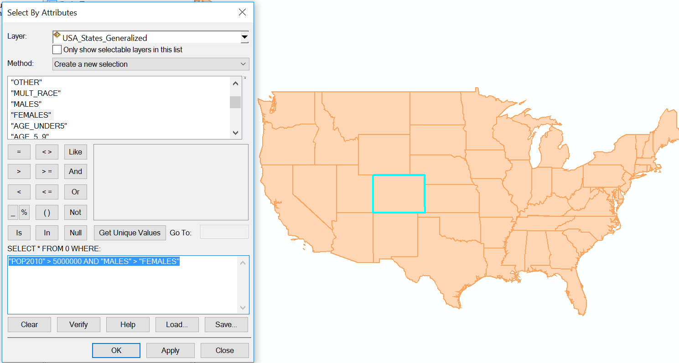
Query by attribute
Multiple queries can combined using logical operator, such as AND, OR, NOT
For example, select all states where male is more than female and population is larger than 5 million, "POP2010" > 5000000 AND "MALES" > "FEMALES"

Slide 26
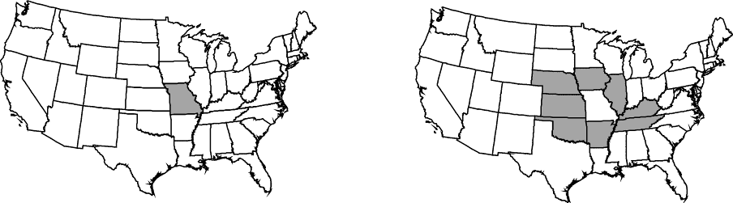
Query by location (Spatial query)
Also called spatial selection, a special type of database query supported by geodatabases and spatial data types.
Identifying features based on spatial criteria, for example, adjacency, connectivity, containment, arrangement
Select states that are adjacent to Missouri

Slide 27
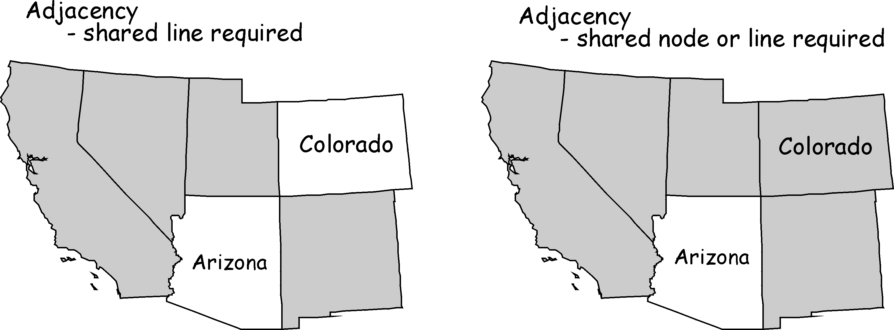
Adjacency depends on the algorithm used
(the same is true for all spatial operations)

Slide 28
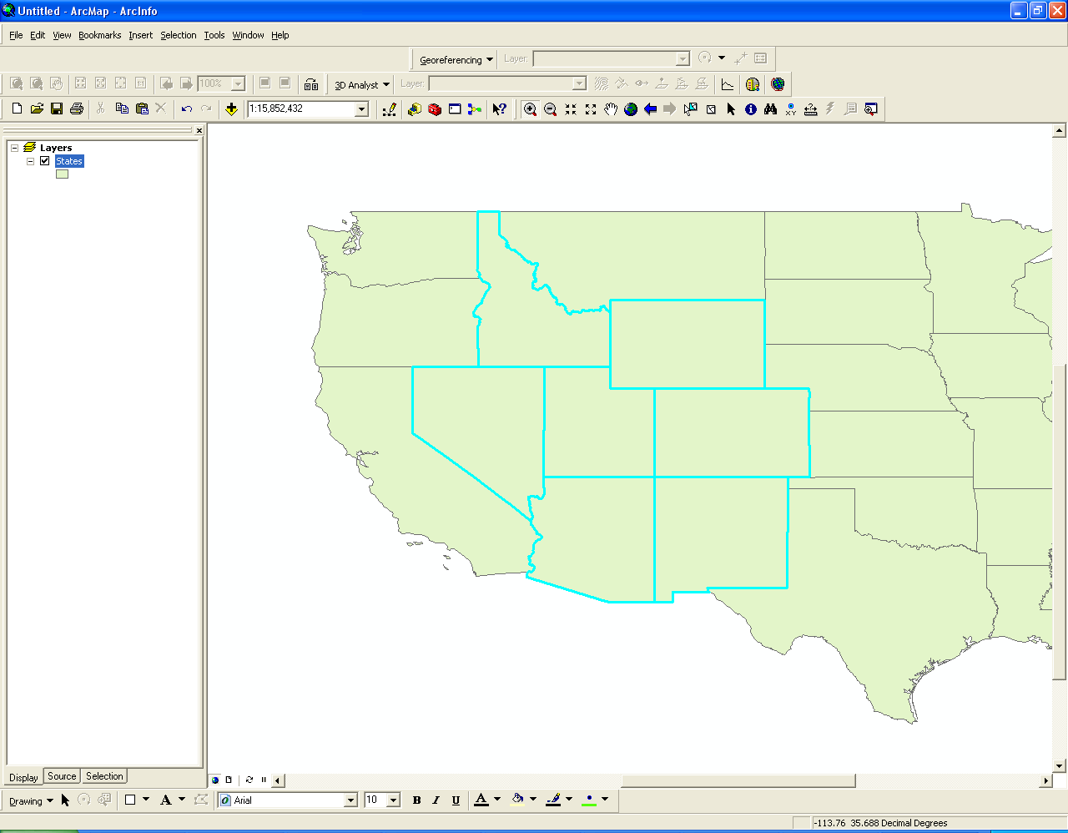
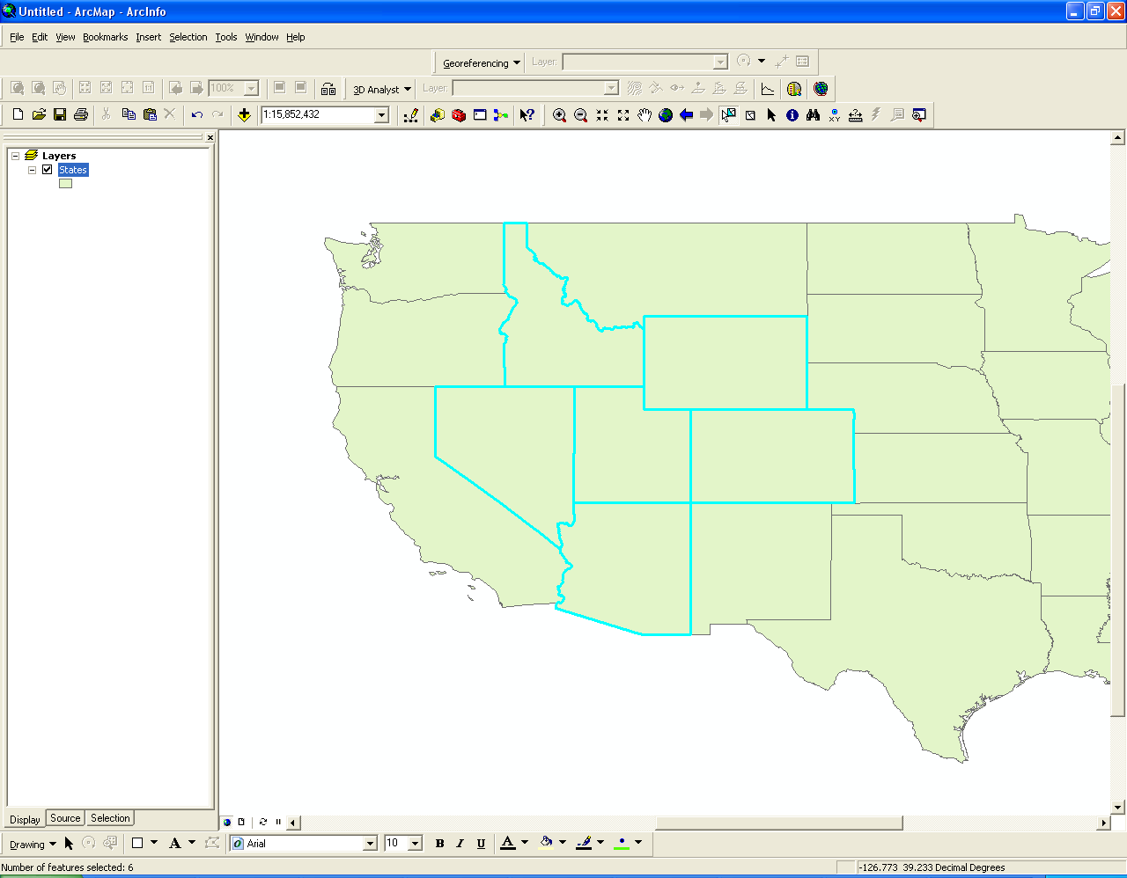
Different Adjacency in ArcGIS
Touch the boundary of
Share a line segment with

Slide 29
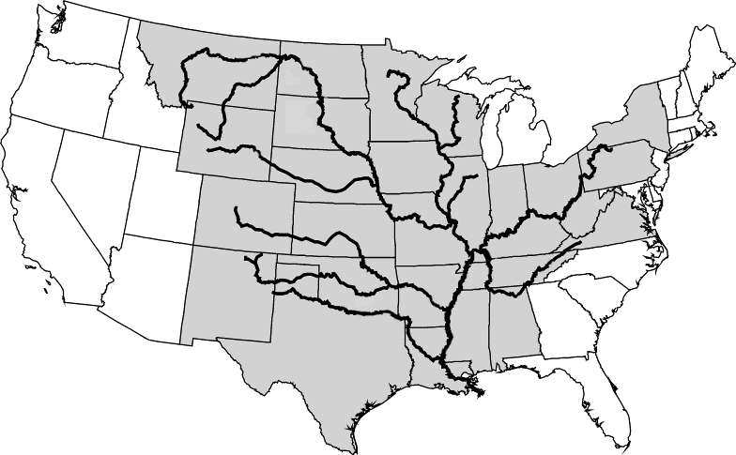
Spatial Selection
Identifying features based on spatial criteria
Adjacency, connectivity, containment, arrangement

Slide 30
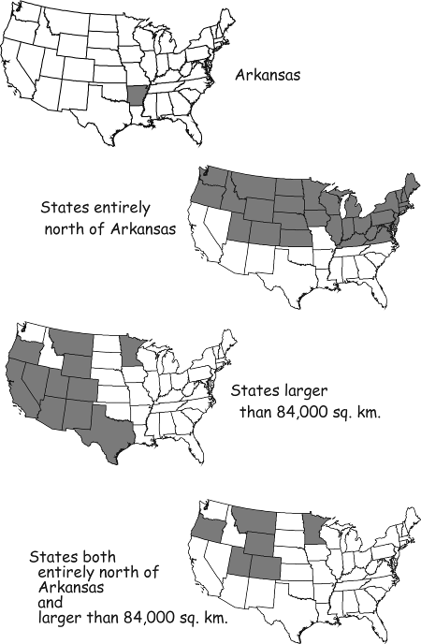
Selection based on spatial and non-spatial attributes

Slide 31
Creating and Editing Vector data
Creating vector features
Creating vector geometries
Splitting vector features
Splitting lines
Splitting polygons
Combining features
Merge
Union
Intersect
Auto-complete polygons

Slide 32
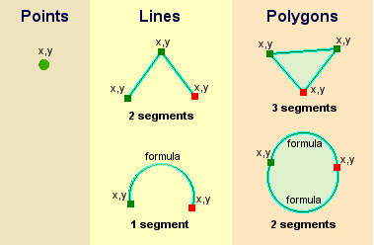
Create Vector Geometries

Slide 33
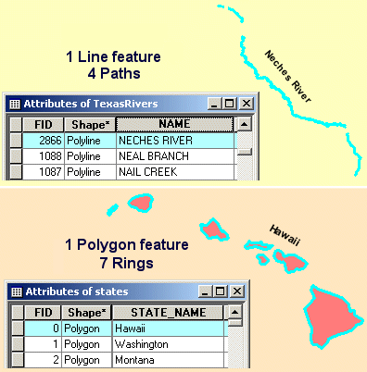
Multi-part Features

Slide 34
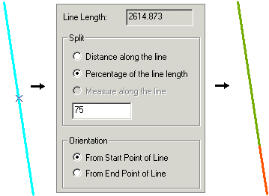
Splitting Lines

Slide 35
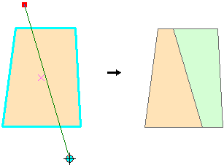
Splitting Polygons

Slide 36
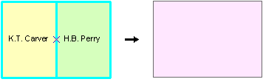
Union

Slide 37
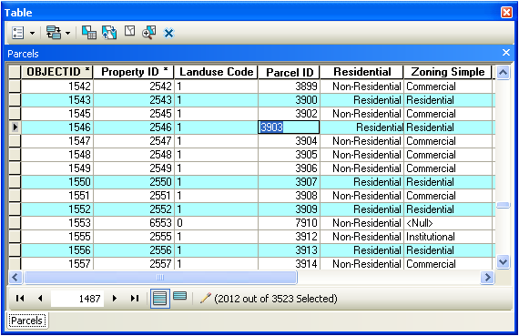
Edit the attribute table
Edit the attributes associated with the vector geometries

Slide 38
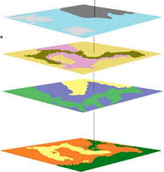
Spatial Analysis in GIS
Identify relationships between or among features and/or layers
Spatial analysis is useful for evaluating suitability and capability, for estimating and predicting, and for interpreting and understanding.
Spatial Overlay is the key method of spatial analysis, which combines information of multiple layers into a new layer.

Slide 39
Spatial Overlay
For vector data, the most common overlay methods are
Clip- the cookie cutter
Erase-the eraser shield
Intersect-keeps data from both data sets
Union- keeps everything from every data set

Slide 40
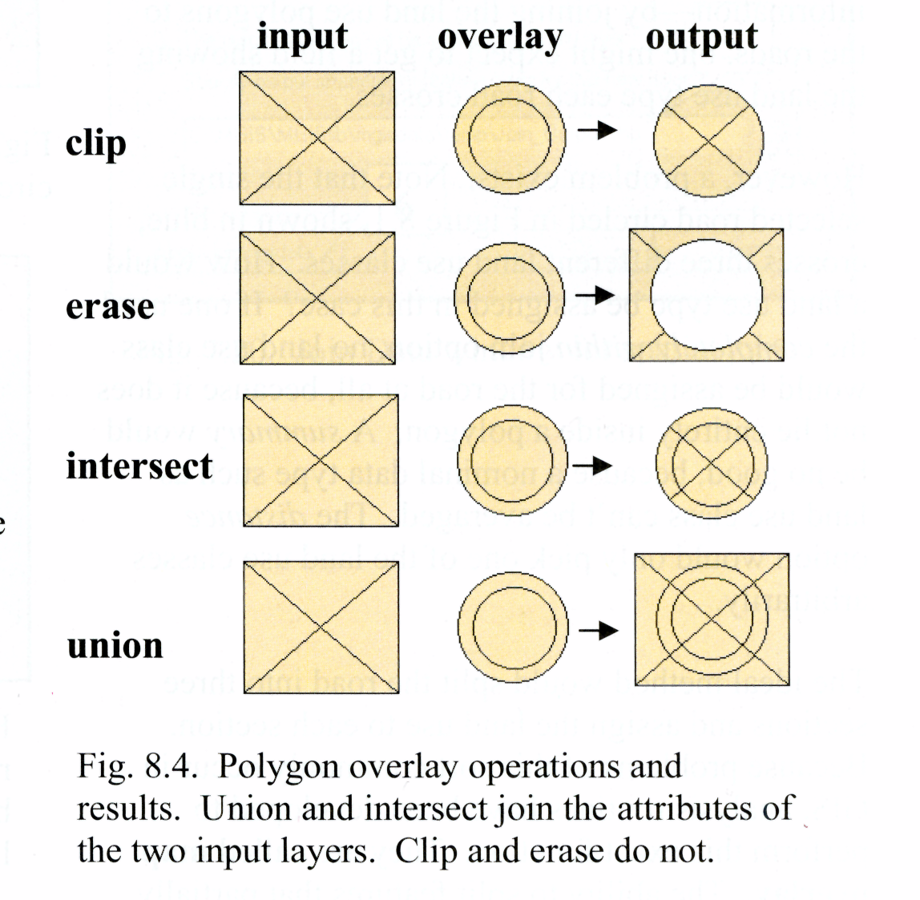

Slide 41
Buffer Analysis
Also known as proximity analysis, creating a zone of interest around an vector feature, or set of vector features.

Slide 42
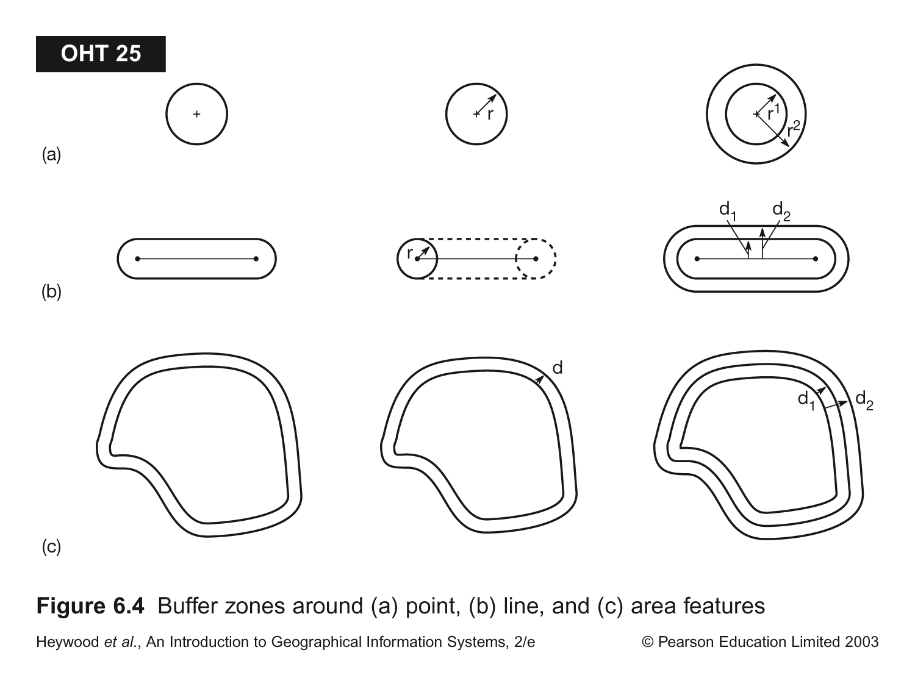
Creating buffer zone
Point
Line
Area

Slide 43
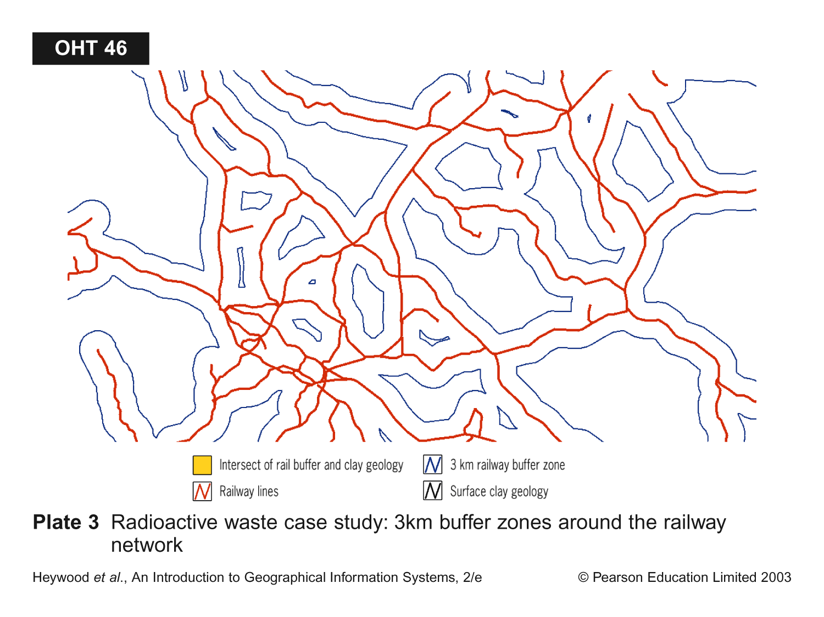
3 km Buffer Zones Around Railway System

Slide 44
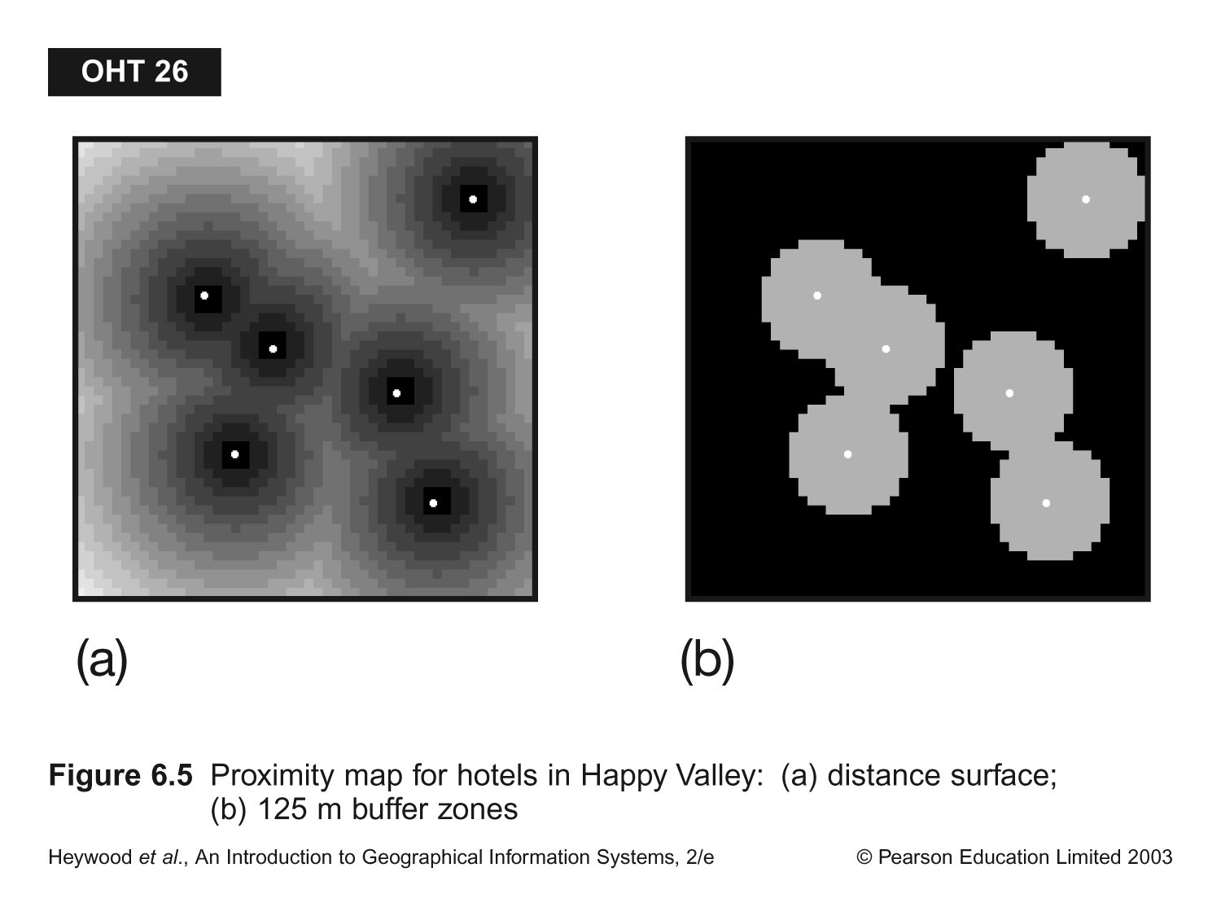
Proximity maps for points of interests
Distance Surface
125 m Buffer Zones

Slide 45
Summary
Topology
Spatial relations that preserves under continuous deformations
The foundation of spatial query and analysis
Queries in GIS
Query by attribute
Query by location (spatial query)
Creating and Editing Vector data
Spatial Analysis
Spatial Overlays – Union, Intersect, Clip, Erase
Buffer – proximity analysis

